Slide 1
Data Analysis Project REPORT
YOUR NAME-PRIYA
TOOLS:EXCEL |PYTHON|POWER BI|JUPYTER NOTEBOOK
Role: Aspiring Data Analyst

Slide 2
PROJECT 1:Colorado Vehicle Sales Analysis
. Analysis of motor vehicle sales data in Colorado
.Objective : identify sales trends and performance
.Dataset includes monthly /yearly sales records

Slide 3
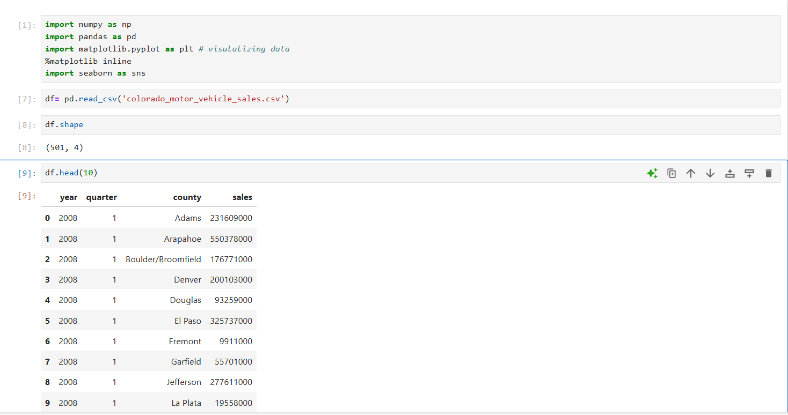

Slide 4
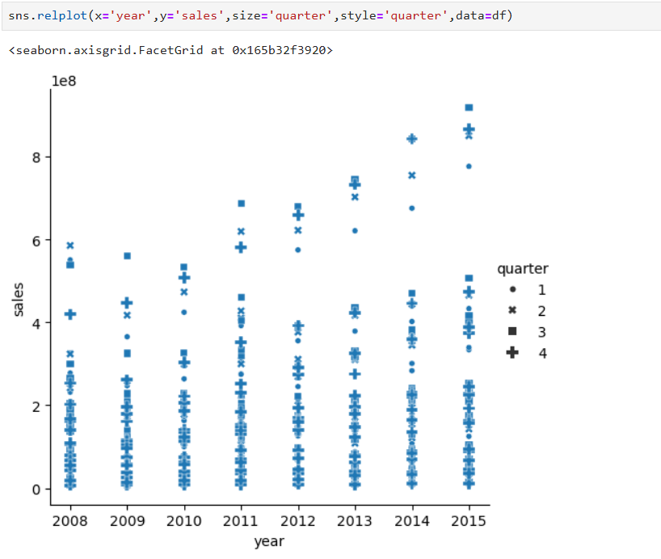

Slide 5
Project 2 : E-Commerce Sales Analysis
Analyzed online sales data using python
Tools: Python,pandas, Matplotlib

Slide 6
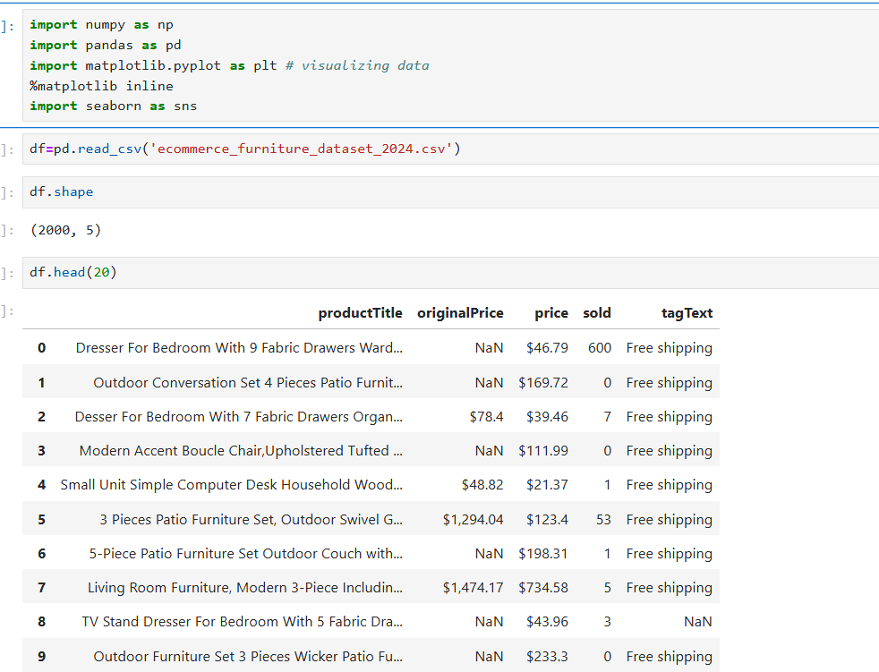
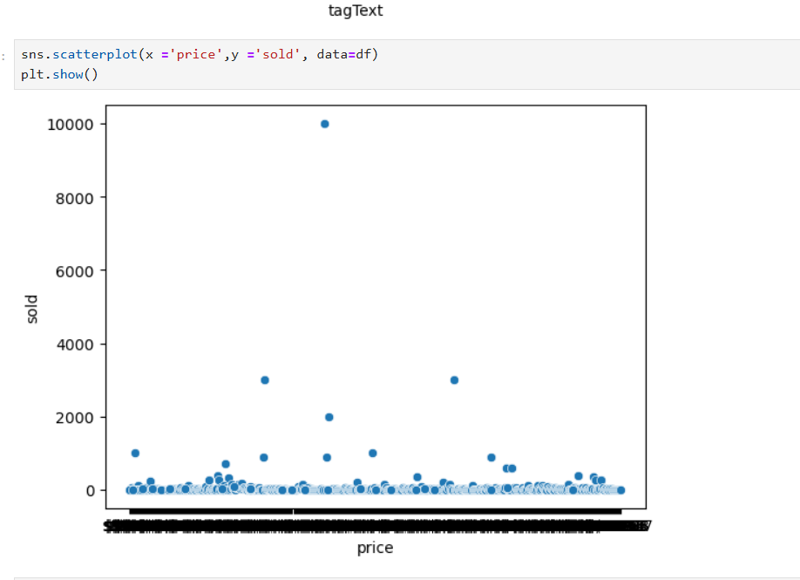
Used pandas for data cleaning
Created visualization for sales trends

Slide 7
PROJECT 3- FINANCIAL DATA ANALYSIS
Financial dataset analysed using power BI
Tools : Excel,Power BI

Slide 8
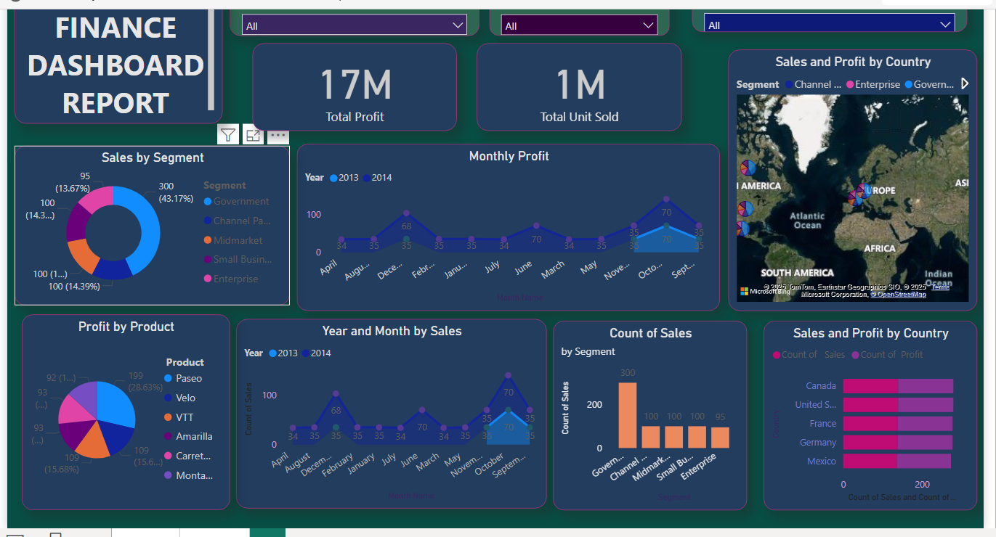
ANALYSIS & KEY INSIGHTS

Slide 9
PROJECT4: Coffee sales Dashboard
Built interactive dashboard in power BI
Analyzed sales by product and payment type
Objective : Understand customer preferences

Slide 10
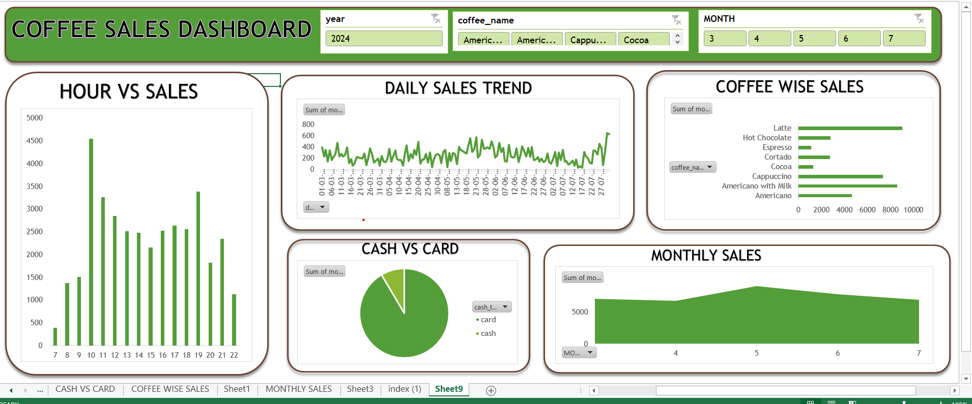

Slide 11
Overall Conclusion
Projects enhanced data analysis skills
Hands-on experience with real datasets
Improved understanding of business insights

